Slide 1

CQRS and Event Sourcing with the “Critter Stack”
August 14th, 2024

Slide 2

Goals of this Workshop
Introduction to Event Sourcing
What goes into building a robust Event Driven Architecture
Convincing you all to use the “Critter Stack!”
Make you love the idea of low ceremony code

Slide 3
Environmental Requirements
Install .NET 8 SDK
Install Docker Desktop
Clone https://github.com/jasperfx/EventDrivenArchitectureWorkshop
From the command line, run “docker compose up –d”

Slide 4
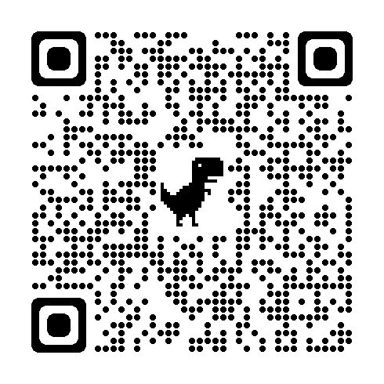


Building a Critter Stack Application Series

Slide 5
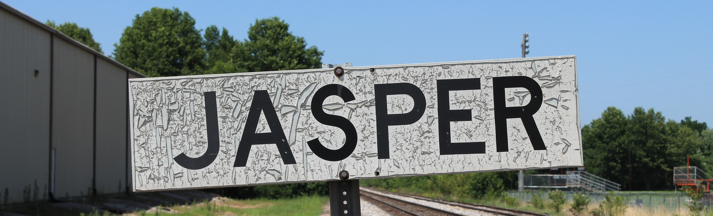
About Me
Owner and Founder of JasperFx Software LLC
Marten Core Team & Wolverine Project Leader
Longtime OSS Author (StructureMap, FubuMVC et al)
https://jeremydmiller.com

Slide 6

The “Critter Stack”
Marten, Wolverine, Weasel (“Mustelidae”)
Toolset for Event Driven Architecture
Low ceremony coding model
High testability & low friction integration testing
Low friction developer experience
Robust system development

Slide 7
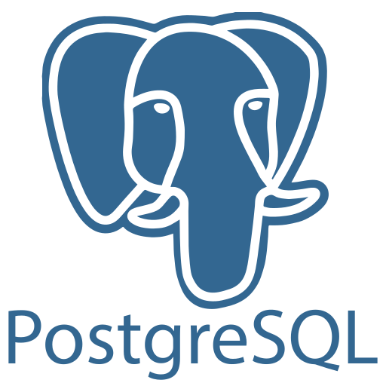
Marten
Open Source .NET Library
Uses PostgreSQL for Persistence
ACID Compliant Document Store
Integrated Event Sourcing

Slide 8

Marten as Document Database

Slide 9
Why a Document Database?
Because you can develop faster, full stop
Handles deep nested structures
Great story for polymorphic entities
Advantageous when entities are self-contained

Slide 10

Event Sourcing
A style of persistence where the single source of truth, system state is a read only, append only sequence of all the events that resulted in a change in the system state.

Slide 11
Advantages to Event Sourcing
Usage of Business Language
Audit Log
Temporal Querying / “Time Travel”
Retrofitting Metrics
Complement to CQRS
Concurrency

Slide 12
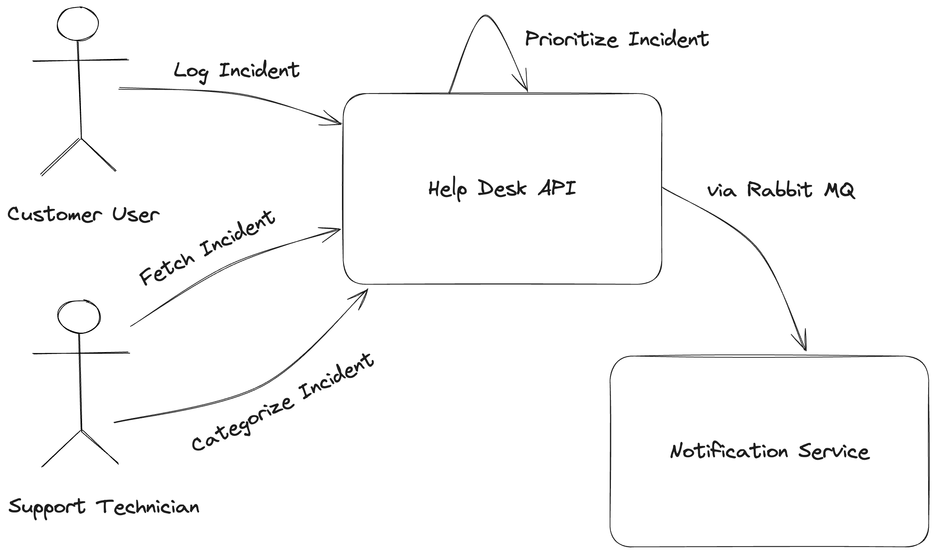
Help Desk API

Slide 13
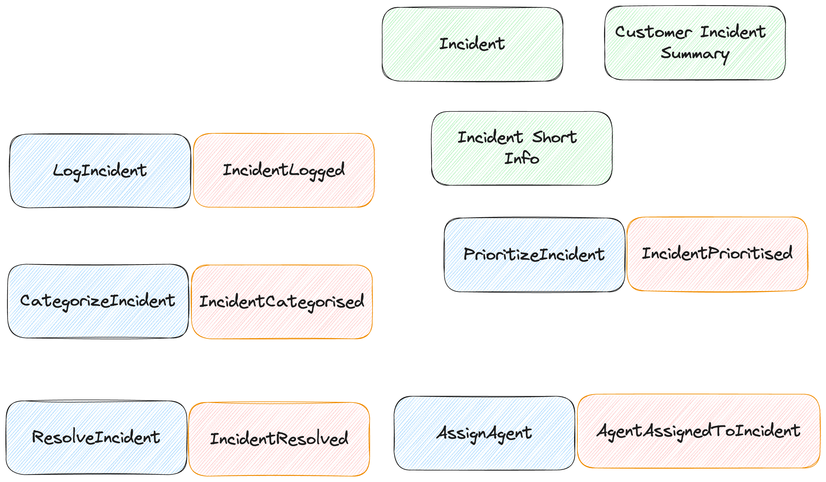
Event Storming – Help Desk Service

Slide 14

Marten Event Sourcing Quickstart

Slide 15

Marten in AspNetCore

Slide 16
Marten Terminology
Event - a persisted business event representing a change in state or record of an action taken in the system
Stream - a related "stream" of events representing a single business workflow or concept
Projection - any strategy for generating a “read side” view of the system state from the events
Aggregate – in Marten terms, a flavor of projection that combines a related set of events into a single view

Slide 17
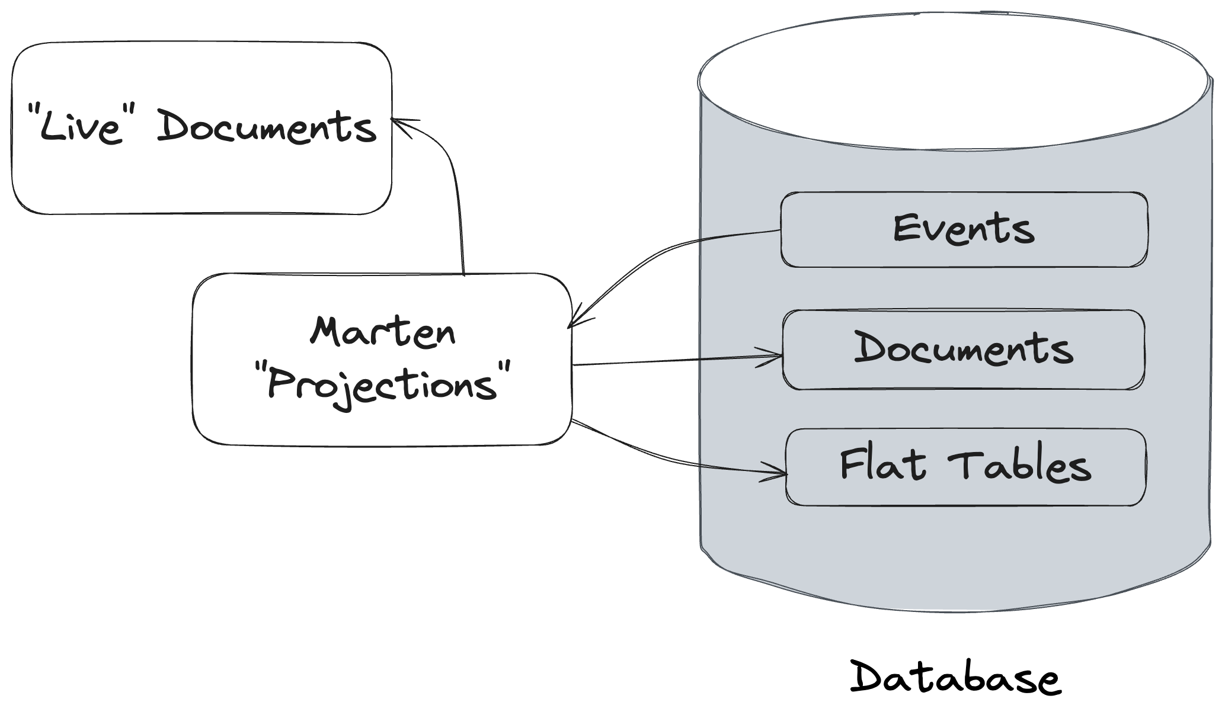
Marten Projections

Slide 18
”Read Side” Web Service

Slide 19

Projection Considerations
Inline – simple approach, strong consistency, slower ”writes”, faster “reads”
Live – simple approach, strong consistency, faster “writes”, slower “reads”
Async – more complicated, eventual consistency, fast “writes”, fast “reads”

Slide 20

Time Travel

Slide 21

Fast Web Services

Slide 22

CQRS
Command Query Responsibility Segregation
A software architectural pattern where “reads” and “writes” are strictly segregated within the system

Slide 23

Building Command Handlers
Validate command inputs
Fetch existing “write” model state
Determine what new events to append
Managing transactions
Concurrency
Error handling and resiliency
Publishing events
Observability

Slide 24
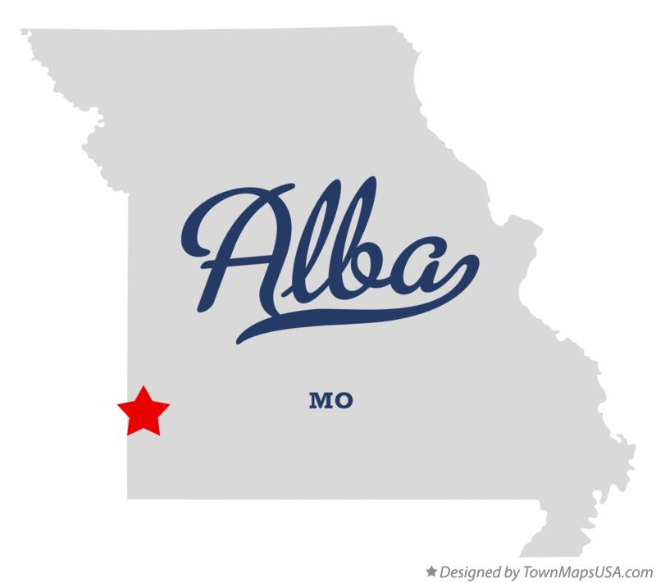
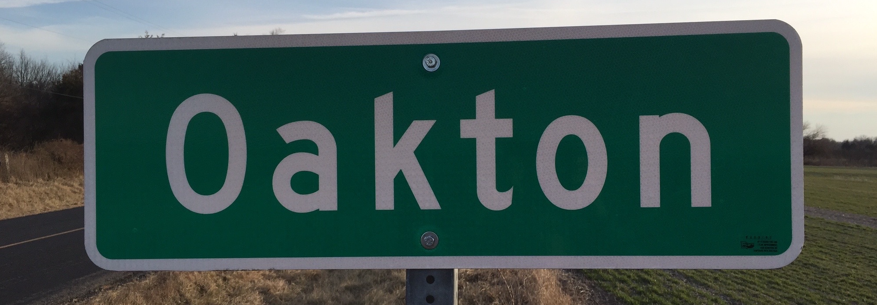
Guest starring…
Alba
Oakton
Easy Integration testing for ASP.NET Core
https://jasperfx.github.io/alba/
Parsing and Utilities for Command Line Tools in .Net
https://jasperfx.github.io/oakton

Slide 25

Automated Integration Testing
Known inputs, expected outcomes
Marten has built in test helpers for controlling system state in tests
“Self-Contained Tests”

Slide 26
Building a Test Harness

Slide 27
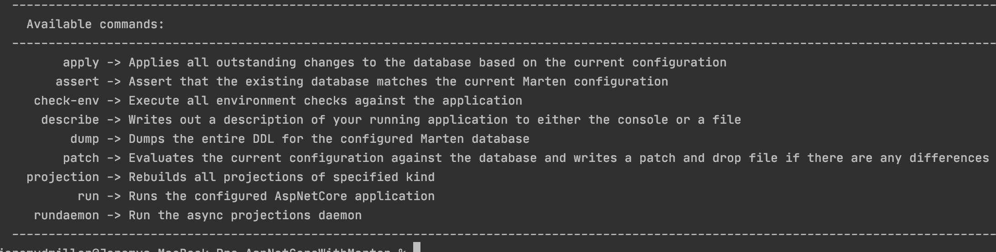
Command Line Tooling

Slide 28
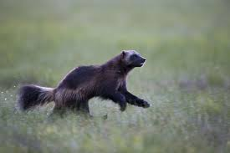
Wolverine
Open Source .NET Framework
Command Executor (“Mediator”)
Background Processing
Asynchronous Messaging
Alternative HTTP Service Framework
Strong Integration with Marten

Slide 29

Aggregate Handler Workflow

Slide 30

What we just saw…
The simplest usage of event sourcing command “writes” on the planet
Business logic in a pure, synchronous function
“A-Frame Architecture”
Optimistic concurrency protections
Wallpapers over “write model” projection lifecycle
“Cascading” messages

Slide 31
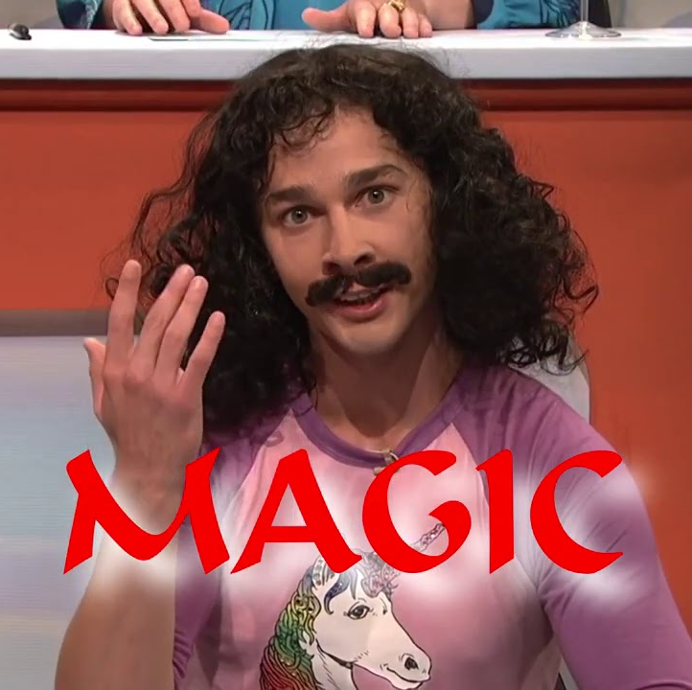
Unwinding the Magic

Slide 32

Wolverine as Mediator

Slide 33

Subscribing to Events

Slide 34

Background work with Wolverine

Slide 35

Drink the Koolaid and use Wolverine for HTTP

Slide 36
Wolverine ”Side Effects”

Slide 37

Fluent Validation Middleware

Slide 38

Integration Testing for Wolverine Message Handling

Slide 39
Vertical Slice Architecture the Wolverine Way

Slide 40

Asynchronous Messaging with Wolverine and Rabbit MQ

Slide 41

Transactional Outbox

Slide 42

The “Stateful Resource” Model

Slide 43

Error Handling and Resiliency

Slide 44

Error Handling Strategies
Retries
Requeues
Scheduled Retries
Discard
Dead Letter Queues
Message Timeouts
Circuit Breakers

Slide 45
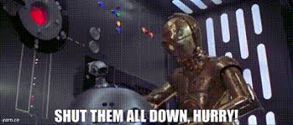
Critical Errors

Slide 46

Designing for Concurrency

Slide 47

Multi-Tenancy
Marten Storage
Conjoined Multi Tenancy
Separate Database per Tenant
Wolverine Tenant Id Propagation
Wolverine Tenant Id Detection

Slide 48

Open Telemetry and Metrics

Slide 49

Resources
JasperFx Software – https://jasperfx.net
Marten – https://martendb.io
Wolverine – https://wolverine.netlify.app

